Slide 1
2016 Trauma Informed Care Conference
Best Practices for Law Enforcement Response to Domestic Calls for Service
Presented by
Brad Grossman
Harper College LEJ Instructor
Palatine Deputy Chief of Police (Ret.)

Slide 2
Law Enforcement Response: Best Practices
Understanding
Response
Assessment

Slide 3
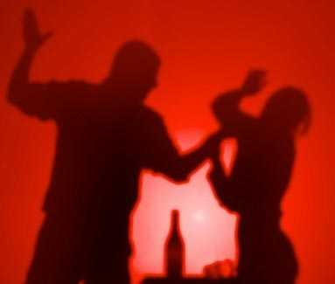
Understanding the Danger

Slide 4
Understanding the Danger
U.S. Department of Justice Study (2010-2014)
An analysis of calls for service involving line of duty deaths reveals domestics are most dangerous type of call for an officer
2015 Fatality Data (NLEOMF)
21% of firearm fatalities were related to domestic violence or domestic related disputes

Slide 5
Arlington Heights Domestic; December 12, 2013
Ofc. Michael McEvoy responds to Domestic Violence call
Eric Anderson was threatening former girlfriend, her mother and mother’s friend with a gun
Upon arrival, McEvoy entered home after hearing shots and brought mother & her friend to safety
After reentering home to save girlfriend, McEvoy was shot in the face by Anderson
Notes:
Backup officers arrived to pull McEvoy to safety and later killed Anderson after a gun battle ensued in garage

Slide 6
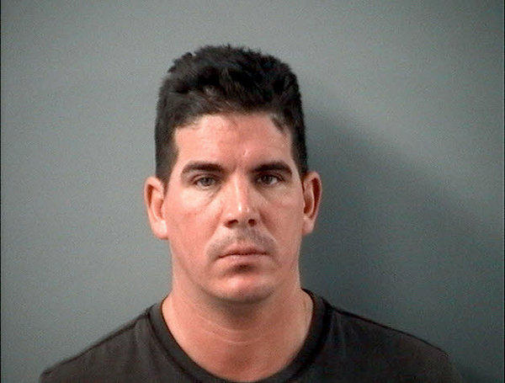
Arlington Heights Gunman
Eric Anderson
"If anybody comes down here, that's it. Any tear gas, anything. I already shot a cop. I am not afraid to shoot her,"
Notes:
Anderson was shot dead by officers after standoff in garage

Slide 7
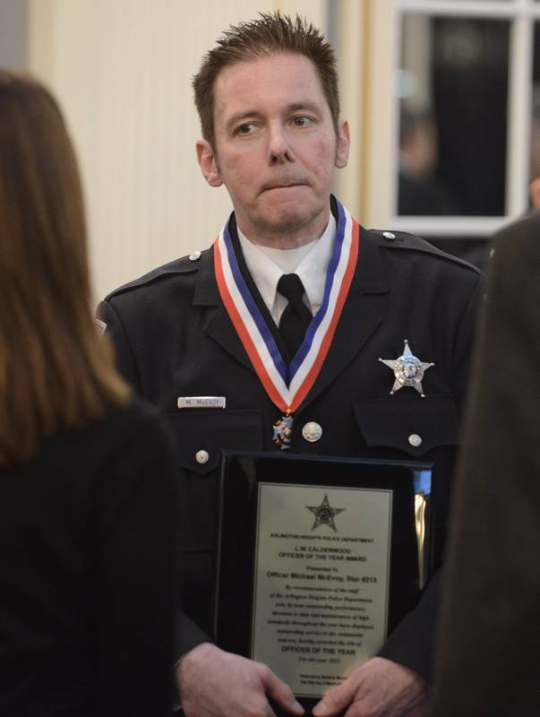
Officer of the Year
Officer Michael McEvoy
"I’m very proud to be an Arlington Heights police officer, and I’m extremely proud to be a recipient of (this) award,"
Notes:
Anderson was shot dead by officers after standoff in garage

Slide 8
Palatine Police Statistics
2015: 718 DV incidents and 136 Domestic Violence Battery arrests
  This averages to 2.34 Domestic Violence calls per day and 2.61 Domestic Battery arrests each week.

Slide 9

Understanding the Survivor

Slide 10
Domestic Violence Hotline Survey (April, 2015)
Both women who had called and those who hadn’t:
25% reported they wouldn’t call in future
> 50% said calling police would make it worse
> 66% feared police wouldn’t believe them or do nothing

Slide 11
Conclusion & Recommendations
Law Enforcement Responses to survivors:
Treat survivors with dignity & respect
Give survivors their ‘voice’ during encounters
Be neutral and transparent in their actions

Slide 12

Understanding ⬄ Policy

Slide 13
Understanding ⬄ Policy
Police Policy: Purpose is to deter, prevent, and reduce incidents of Domestic Violence
A clear understanding of department policy will help lead to a better response

Slide 14
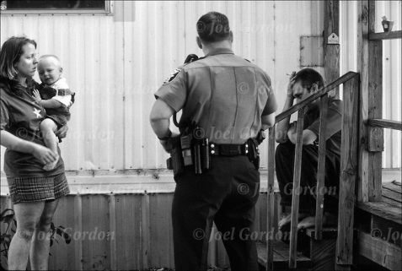
Response

Slide 15
Response
Safety
Sensitivity
Securing Evidence

Slide 16
Response ⬄ Safety
Approach & Arrival – DOJ Study
While enroute, intel is critical; Call history, weapons involved, criminal history of suspect, is suspect still on scene
Two or more officers - DOJ Study
Wait for backup, unless exigent circumstances exist!
Separating victim & perpetrator
Keep from overhearing comments and obtaining weapons in the home

Slide 17
Response ⬄ Sensitivity
Sensitivity: Treating the parties involved with dignity and respect will go a long way in calming the situation upon arrival and communicating to the victim you care sensitive to their situation.

Slide 18
Response ⬄ Securing Evidence
Successful Prosecution = Documentation
  Verbatim victim statements upon arrival
  Victim’s condition (e.g. scared, crying)
  Verbatim offender statements
  Photograph & document injuries
  Document presence & age of children
  Document damage/disarray of home caused by offender to show struggle

Slide 19

Assessment

Slide 20
Assessment
Risk: Determine level of danger to victim and determine if Safety Plan is needed
Assistance: Domestic Violence Information handout, Social Services Referrals, shelters, community resources, standing by, medical assistance

Slide 21
Conclusion
Understanding
Response
Assessment

