Slide 1
SHOTS FIRED Active Shooter Training

Slide 2
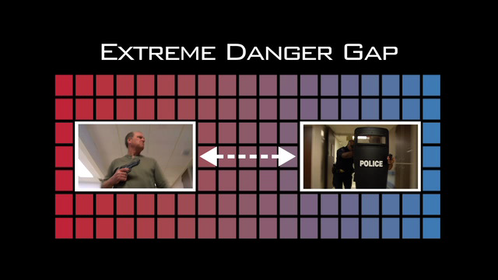
Extreme Danger Gap
e interval between the onset of violence and the arrival of first responders

Slide 3
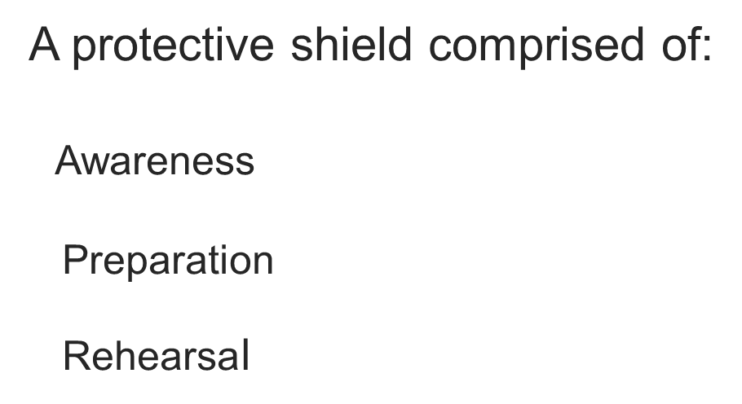

Survival Mindset
A protective shield comprised of:
Awareness
Preparation
Rehearsal

Slide 4

Awareness
Workplace violence can happen anywhere and to anyone
Basic understanding of an active shooter situation
Recognizing changes that may reflect a potential for a problem in the making

Slide 5
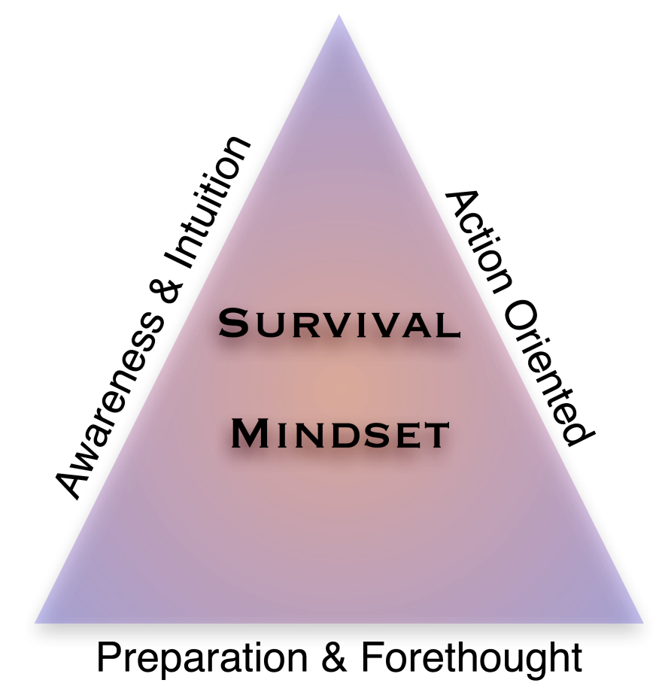
Preparation
Look at your work environment through a survival lens
Ask yourself the “what-if” questions
Prepare mentally and emotionally to survive

Slide 6
Rehearsal
Practice your plan
Mentally & Physically walk through your “what-if” plan
Reduces response time… Builds confidence
Serves as a survival “inoculation”
Integrates your specific policies and procedures for responding to a critical incident

Slide 7
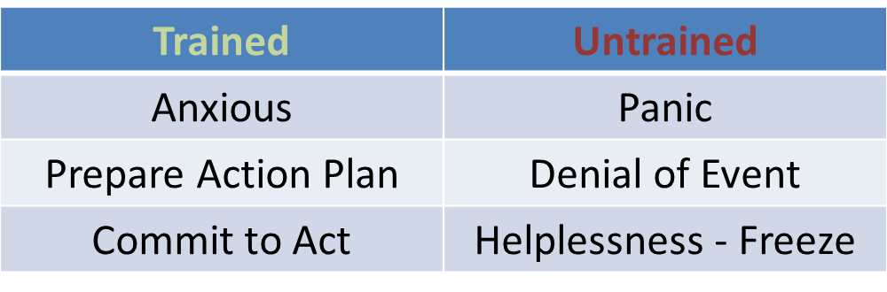
Trained vs. Untrained
Typical Responses

Slide 8
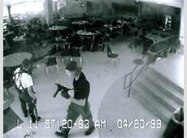
Response Measures
ACCEPT
• Accept that a violent incident is occurring
• Recognize real gun fire sounds different than in movies
• Trust your intuition

Slide 9

Response Measures
ASSESS
Quickly, gauge what’s occurring
• Continuous evaluation process
Assess your options
• Get out? Escape? Hide?
• Protect? Who? Where?
• Confront the shooter? LAST RESORT!

Slide 10
Response Measures
ACT
Avoid
• Get out fast; don’t wait for others to validate your decision
Barricade
• Put anything you can in between you and the shooter
• Avoid places that might trap you or impede movement
Fight… Last Resort
• If escaping or hiding are not possible, neutralizing the shooter in some way
may be your only option… CONTROL HANDS
• Any action you take may be your only means of survival

Slide 11
A L I C E
A-LERT
L-OCKDOWN
I-NFORM
C-OUNTER
E-VACUATE

Slide 12
A L I C E
Alert:
Get the word out! First call 911 and then call the office. The office will then alert everyone. The office will use clear, concise language to convey the type and location of the event.

Slide 13
A L I C E
Lockdown:
Good starting point after you have been alerted. Lockdown involves barricading the classroom door so that no one can get in

Slide 14
A L I C E
Inform:
Inform 911 and the main office of the description of the shooter, direction of travel and anything else that would be necessary for the incoming police officers. Communication keeps the shooter off balance.

Slide 15
A L I C E
Counter: How?
Stimulus and Swarm
Overload shooter with stimulus
(noise, throw objects, movement, etc.)
Swarming techniques = acting together to overtake a gunman

Slide 16
A L I C E
Evacuation:
Reduce the number of potential targets.
Evade/Escape from the building if you know the shooter is nowhere near you.
Gather at designated rally points

Slide 17

Neutralizing the Threat
Taking actions to disrupt the shooter’s actions or incapacitate the shooter
• Throw things, yell, use improvised weapons
• Develop an action plan and work as a team
• Success requires a total team commitment

Slide 18

Response Measures
ALERT When you get out, immediately notify authorities
• What law enforcement needs to know
Name, if known
Number of assailants
Description
Location
Number & type of weapons

Slide 19
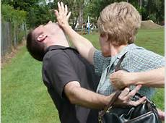
Defensive Actions
If a code announcement is made over the PA about an active shooter, you must consider the following
• Are you alone?
• Are others nearby?
• Can they help you and themselves?
• Are you near class rooms?
• Are there rooms with inside door locks?
Whatever actions you decide to take, help others to escape as you go

Slide 20
Active shooter vs. Hostage Taker
Active Shooter
Typically an individual but groups also possible
Operate in either close quarters or open environment
Random or specific targets
Armed individual who has used deadly force
Has unrestricted access
Hostage Taker
Armed individual or group who may or may not use deadly force
In most cases, access is restricted
Wants to use people as leverage
Realizes importance of keeping hostages alive
Suffering from acute stress that disrupts ability to function normally

Slide 21
Active Shooter vs. Hostage Situation Differences
Active Shooter
Armed individual(s) who has used deadly force
Continues to do so with unrestricted access
Can involve:
Single shooters, multiple shooters
Close encounters, distant encounters
Targeted individuals, random victims
Single-room confrontations, mobile confrontations
Situation not necessarily contained to a specific location
No two situations alike – Highly Dynamic

Slide 22
Active Shooter vs. Hostage Situation Differences
Hostage Taker
Primary motive:
Substantive
Holds hostages to force fulfillment of demands
Makes direct or implied threats to harm hostages
Usually compensating for some type of loss
Expressive
Holds hostages to make some sort of “statement”
Personal or Political
Significant difference is containment of both offender(s)
and victim(s)
May or may not have used deadly force
No two situations alike – Highly Dynamic

Slide 23
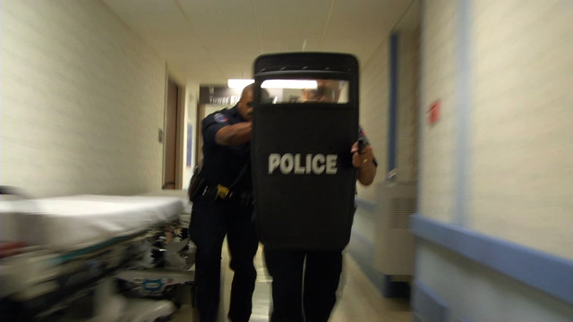
Law Enforcement Response
Will not know if you are a threat
Hands kill
• Raise your arms, spread your fingers, show your hands as
you drop to the floor
If officers enter a room where you are located
• Do not point at them or the shooter
• Do not scream or yell
• Be quiet and compliant
• Give them requested information on the shooter
Number, Description, Location, Type of weapon

Slide 24
Follow the officers direction
Once you are out of the building and safe contact your direct supervisor and family to confirm your safety.

Slide 25
QUESTIONS
?

