Slide 1
Art Therapy & Working with Children Exposed to Domestic Violence
Mary Usdrowski, LCPC, ATR

Slide 2
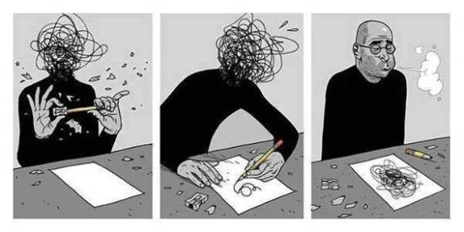
“So you play with crayons all day?”
Art Therapy Humour “art therapy helps to get what’s in your brain out on paper” Mead. N. – Art Therapy Without Borders 2014

Slide 3
What is Art Therapy?
“Art is the meeting ground of the world inside and the world outside”-Elinor Ulman
Uses the creative process of making art to improve a person’s physical, mental, and emotional well-being.
Express and understand emotions through art making and through the creative process.
Art is it’s own language which speaks to us in ways words cannot.
“Art therapy is a mental health profession in which clients, facilitated by the art therapist, use art media, the creative process, and the resulting artwork to explore their feelings, reconcile emotional conflicts, foster self-awareness, manage behavior and addictions, develop social skills, improve reality orientation, reduce anxiety, and increase self-esteem.” AATA
All art is acceptable, there is no right or wrong way

Slide 4
Qualities of Art Therapy
Art therapists are trained to pick up on nonverbal symbols and metaphors that are often expressed through art and the creative process, concepts that are usually difficult to express with words.
Utilize non-verbal cues
Observe symbols and metaphors
Utilize the creative process to transcend emotional experiences
“The creative process involved in the making of art is healing and life enhancing”-Cathy Malchiodi

Slide 5
Beliefs/Values
Inherent capacity for art making and creativity
Art making is an intuitive process
Art involves a sense of play
Transformative power of art lies in the ability to lose ourselves in the activity and express previously unknown aspects of ourselves
“Artistic creativity is a shared human experience that transcends disability or environment”
The process is important, not the product-pleasure derived from creation
Art can externalize feelings/painful experiences
Requires intention, courage, and active participation

Slide 6
Art Therapy History
Grew from the psychoanalytic movement and beliefs about the symbolic content of images from patients’ art and dreams
Freud observed his patients could draw their dreams, but unable to describe them in words
1940s, Margaret Naumburg was first to delineate art therapy as a distinctive form of psychotherapy; symbolic speech; transference
1946, Edward Adamson worked as an artist with patients in a hospital studio; provided a place to paint and to “cure themselves”; intrinsic healing qualities of the art process
Menninger Clinic, Topeka, Kansas; psychiatric facility 1930s offered art classes to patients; Mary Huntoon (trained artist) assisted patients to use art to process and release emotional problems and trauma; artsynthesis (process of self-discovery)

Slide 7
Art Therapy History
1950s, Edith Kramer proposed the healing potential; stressed importance of creativity rather than only the communication of symbolic speech
1950s/1960s, Hanna Yaxa Kwiatkowska introduced art therapy into family sessions; specific drawings were helpful in identifying family roles and encouraged positive therapeutic experience of family working together
Robert Ault and Don Jones helped establish the American Art Therapy Association in the late 1960s with colleague Myra Levick
IATA is a not-for-profit corporation established in 1974 where “art therapists, art therapy students and other interested professionals could gather to exchange information and experiences concerning the therapeutic use of art”

Slide 8
Art and Mental Illness
1872 Ambroise Tardieu, French psychiatrist published a book on mental illness and characteristics of artwork created by people with mental illness.
1888 Paul Max Simon, French psychiatrist published a series of studies of the drawings of people with mental illness. One of the first psychiatrists to establish a large collection of drawings and painting by patients in insane asylums. “Symptoms could be related to content of artwork”.
1920s, Hans Prinzhorn collected art from doctors and hospitals throughout Europe and published Artistry of the Mentally Ill. Interested in the creative process and visual forms created by “Outsider” artists. Art making was “a universal, creative urge”.
Walter Morgenthaler, Swiss psychiatrist, published a book on the art of Adolf Wolfli who was diagnosed with schizophrenia. Confined to psychiatric hospital for more than 30 years and created numerous images.

Slide 9
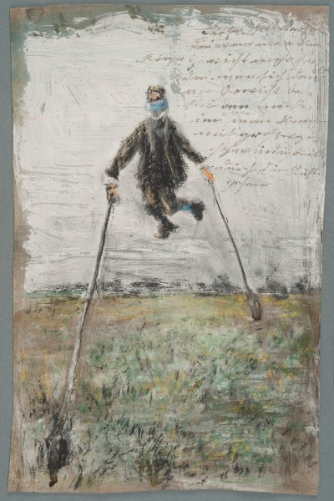
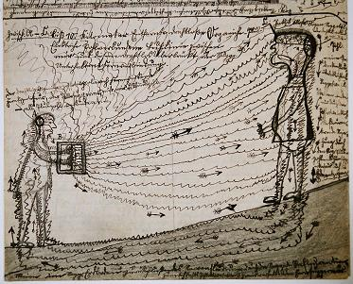
Jakob Mohr, 'Proofs', 1910, Prinzhorn Collection
Josef Forster/ Sammlung Prinzhorn

Slide 10
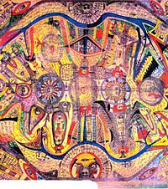
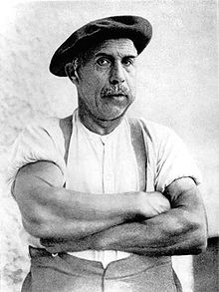
Adolf Wölfli
General view of the island Neveranger, 1911

Slide 11
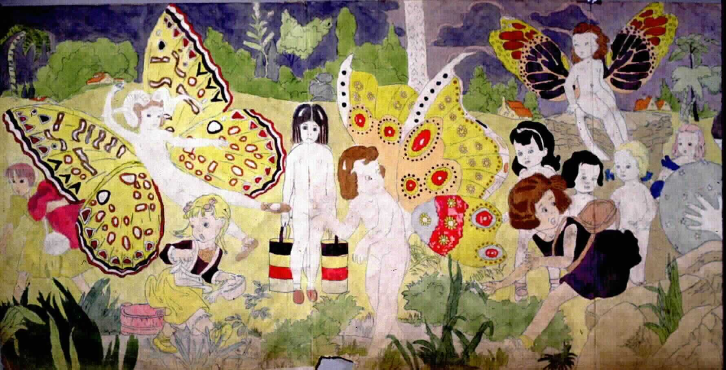
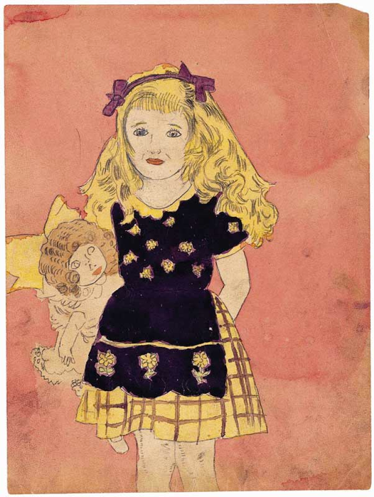
Outsider Art
Intuit: 756 N. Milwaukee Avenue, Chicago
Established in 1991, Intuit: The Center for Intuitive and Outsider Art (Intuit) is the only nonprofit organization in the United States that is dedicated solely to presenting self-taught and outsider art
Henry Darger - Realms of the Unreal
Henry Darger -The Lonely One

Slide 12
Art Interpretation/Assessments
Goodenough-Harris 1926 Draw-A-Man test (draw the best man possible and include whole figure; non-verbal intelligence test for language impaired children)
House-Tree-Person, 1948 Buck; series of 3 drawings for personality evaluation
Machover’s Draw-A-Person test 1949 (personality assessment)
1970 by Burns and Kaufman’s Kinetic Family Drawing (family dynamics and child’s attitude towards family)
Interest in the art created by people with mental illness led to using images to diagnose and evaluate mental conditions (projective testing)
Art was seen as a way to help understand and decipher the unconscious mind
Research debating recurring symbols or styles connected to emotional disorders
Meaning of art image is personal and can change over time

Slide 13
“So I asked what Art Therapy is and I get lots of different answers?”
Art as therapy-art making itself is therapeutic
Art Psychotherapy
Art Interpretation
Therapy with art materials
“Art is a way of knowing what we actually believe”
-Pat Allen, Art Is a Way of Knowing

Slide 14
Variations-Art as Therapy
“Drawing from Within”: Emphasis on expressing images/thoughts/emotions that come from within
-Individual makes meaning and follow their own personal process of making art
Inherent healing properties of art and the creative process
Utilizes metaphors (from images to how client interacts with the materials)
Leads to personal fulfilment, authentic self, emotional healing and being at peace.
Client comes up with their own interpretation of their art; highly personalized

Slide 15
Variations-Art Psychotherapy
Symbolic communication
Emphasis on “the product”
Image itself enhances verbal communication in order to achieve insight
Resolves conflicts, problem solving, explore alternative perspectives
Directive at times (Ex. Esteem Sculpture, Art Assessments)
Clarifying, Questioning, Confronting, Interpretation (make connections between images and feelings/behaviors/perceptions)

Slide 16
Directive and Non-Directive
Directive
Ex. Draw a picture of your family
Non-Directive
Ex. Draw a picture of whatever you like
Depending on the purpose of session, treatment goals, and ultimate comfortability of the client, either approach is warranted.
Sometimes using images to self soothe and create positive sensations is warranted
Provides the opportunity to dialogue with your art (what is it trying to communicate?)

Slide 17
Examples of Directive Art Activities
Scribbles to create spontaneous imagery (eyes closed, non-dominant hand)
Mandalas (relaxing/meditative properties as well as signs for transformation and change)
Non-verbal family joint drawing
Creative genograms: using colors/shapes/symbols that may reveal unconscious beliefs or perceptions
Visual memorials for those you have passed (remember, record, and immortalize)
Creating a safe place (visualizing and recording)
Self-portraits/Family portraits
Drawing of triggers and coping skills
Safety Box
Feelings’ Mask

Slide 18
Open Art Studio Groups
Non-directive emphasizes acceptance, receptive listening, and respect for people to solve their own problems
Non-directive approach
Contrast to art psychotherapy groups (based on a specific theme)
Often perceived as artists more than patients
Using art making as a process for self-expression, exploration, and healing
Based on art groups offered in hospitals during 40s and 50s
Patients who attended these studios could come and go as they pleased (“open studio”)
Emphasis is on art process to uncover and develop meaning versus traditional talk therapy
The Open Studio Project, Chicago; provide programs to expose participants to value of the creative process
“Witnessing” (works best with no comments from the viewer-P. Allen); honors the content of images, not interpretation; support and respect others’ experiences and creative potential

Slide 19
How to utilize art therapy techniques when working with children exposed to DV?
“Children who witness and live in this violence retain, recall, and react to their environment in a continuous state of threat, terror, and alarm.”
-B. Perry, Considerations for Art Therapy & Children from Violent Homes

Slide 20

Symptoms identified in Children
Sleep disturbances
Hypervigilance
Increase startle response
Depression
Irritability
Anxiety
Biting
Lack of empathy
Repetitive play
Fearfulness
Nightmares
Aggression
Separation anxiety
Low self-image & self-esteem
Difficulty concentrating
Intrusive thoughts
Decrease in attention span

Slide 21
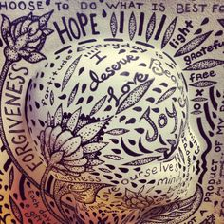
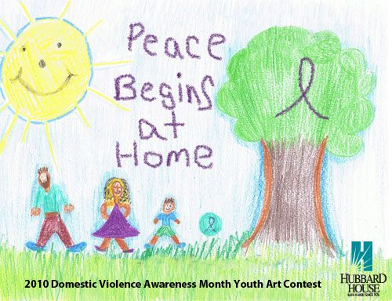
Environmental considerations
Emotional expression, validation, acceptance
Reduce anxiety and fear
Adjust to shelter life, changes within the family
Safety planning
Provide a sense of safety and predictability
Allow messes
Permission to freely create

Slide 22
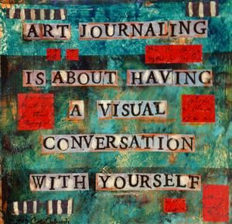
How Trauma is Expressed in Art
Animals, colors, characters (i.e.. Monsters) can assist children with processing trauma through a non-threatening image
“Art expression is one way to communicate what is unspoken and unspeakable… By providing these children with the chance to express their inner worlds through art, we inevitably offer them the opportunity to release the inner monsters that torment them and ultimately rob them of trust, safety, happiness and a sense of wholeness.” –Cathy Malchiodi
Safety, protection
Fear of someone breaking into the home
Images and verbalizations regarding anxiety, violence, fear

Slide 23
Art & Trauma Intervention
Goal is to create a safe environment, sense of safety internally & externally (using a blanket to identify boundaries)
Feel safe to make art free of judgment , interpretation, and being asked too many questions
Opportunity for storytelling, providing a voice
Build resiliency, focusing on strengths
Making choices
Appropriate role modeling to aide with re-establishing trust and learn empathy
Distance painful experiences from self/externalizes the internal
Educate and normalize trauma reactions
Stress management
Validation of experience
Learn to express and release feelings
Permission and acceptance of emotions (fear, worry, anger, guilt, humiliation, sadness, betrayal)
“Not your fault”
Slowly and safely release these experiences
Relational support
Create and envision a future
Instill Hope
Problem solving, flexible thinking

Slide 24
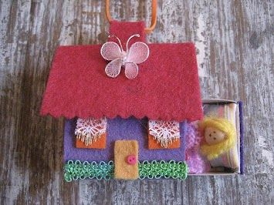
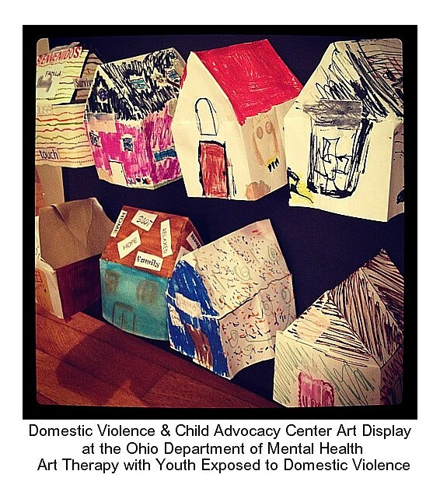
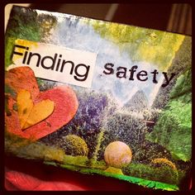
Safe Places/Home
(Boxes, Buildings, Drawings)

Slide 25
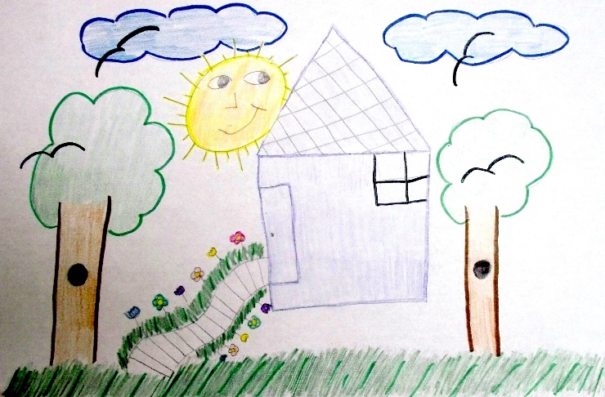
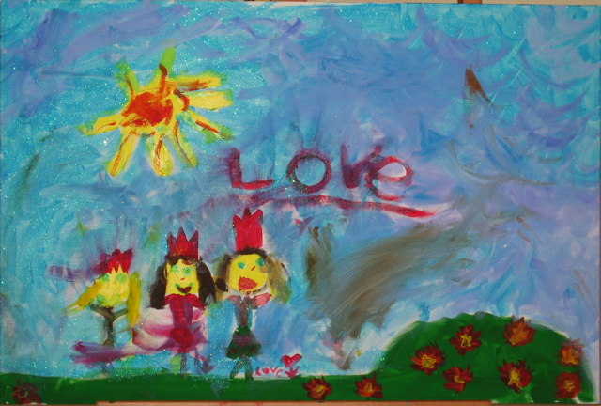
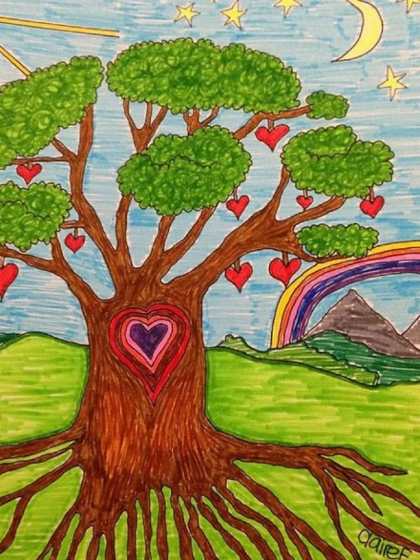
Transitional Safe Place
Create an image of a safe place/scene that can be carried with someone as a reminder and tool for grounding oneself.

Slide 26
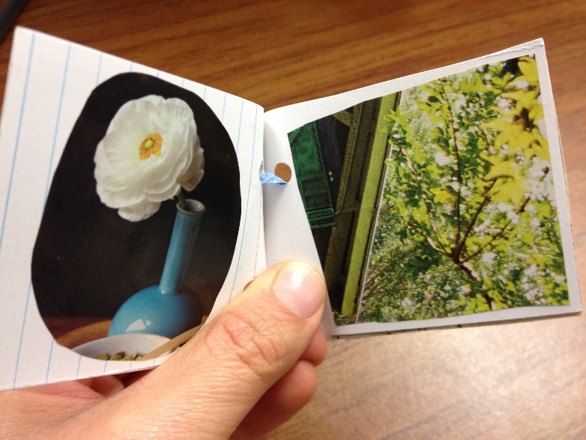
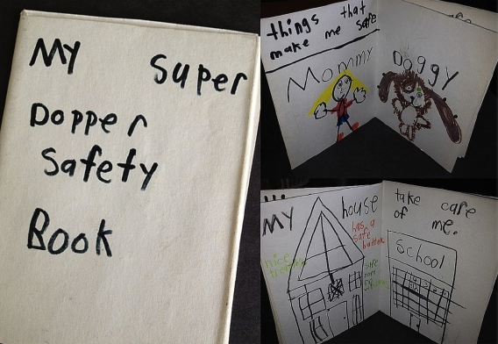
Safety Books: Reminders for what makes me feel safe

Slide 27
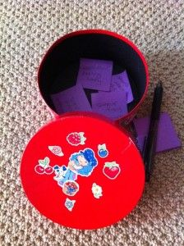

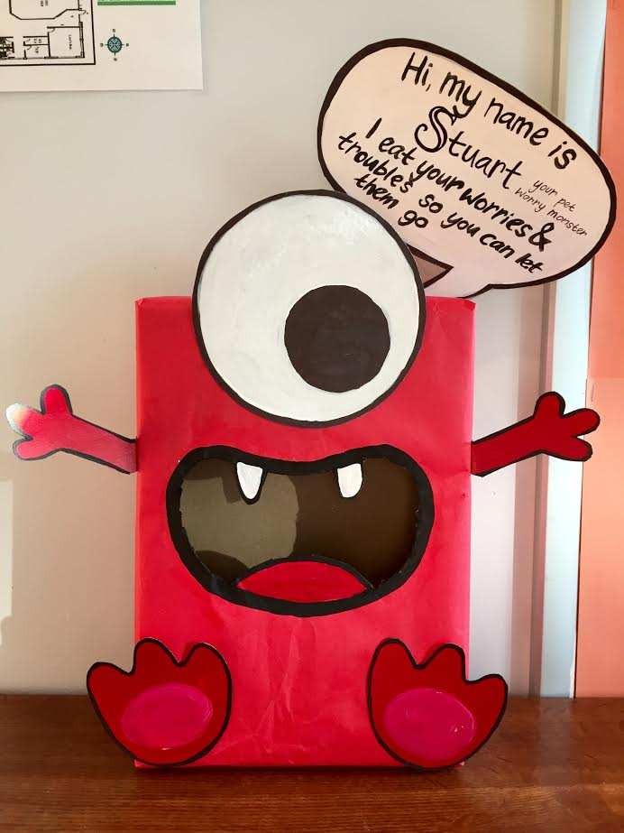
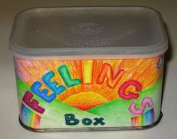
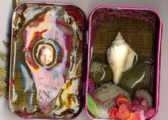
Worry Monsters/Feelings Boxes

Slide 28
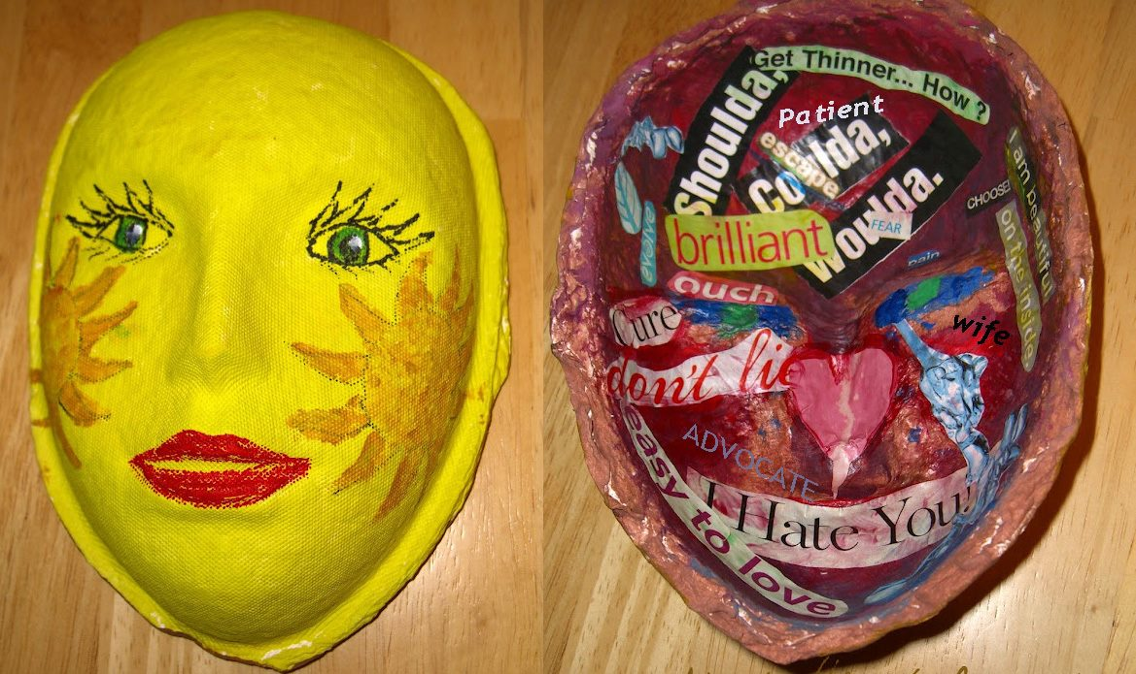
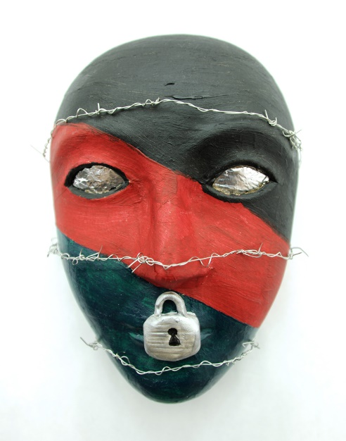
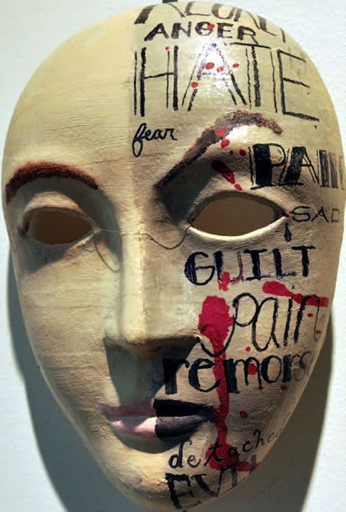
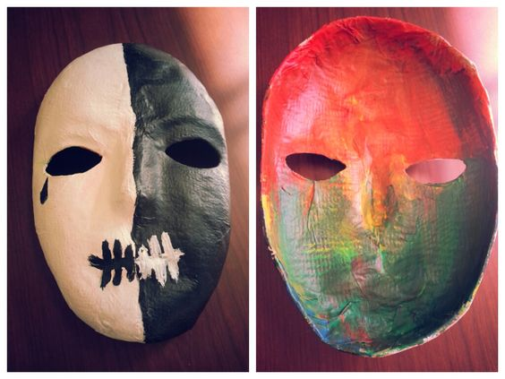
Masks

Slide 29
Uses of Art Therapy
Emotional outlet
Creative expression
Problem solving/creativity
Increasing attention span
Manage emotions appropriately/coping skill
Self-exploration
Reduce stress
Personal growth/self-understanding
Open channels to emotions that have remained unconscious
Improve social skills
Communication
Process trauma in a non-threatening, tangible way
Restore functioning levels
Improve personal well-being
Resolve conflicts
Improve interpersonal skills
Intrinsic pleasures of art making
Increase self-esteem/sense of pride
Encourage appropriate risk taking
Teach new skills

Slide 30
Power of Materials
Characteristics of materials impact sessions/art-making activities/emotions
Fluid=watercolors, paints, chalks (easier to manipulate, but harder to control)
Fluid materials benefit those needing to become more open, permission to play, freely express themselves; children who’ve experienced trauma, guarded/restrained, timid, lost ability to play-However, can also stimulate regression
Resistive= pencils, felt-tip markers, collage (more precise, detailed, easier to control)
Resistive materials benefit clients needing more structure, reducing anxiety or energy level; produce a calmer state
Offer choices, but create containment and control

Slide 31
What to say…?
Provide an environment without judgement
Show interest
Don’t assume what the objects are created in the image/sculpture; reserve interpretation or assumptions
Actively listen
“What would you like to share”, “Tell me about your creation/image”…
Do not provide good or bad labels
Praise effort and notice specifics: colors, lines, perspective

Slide 32
Limitations
Just with any other modality of therapy, there are limitations
“Resistance” vs. You just don’t like to make art
Other modalities are more gratifying: dancing, music, poetry, sports
Difficulty being spontaneous due to previous art experience
Challenge creating something that is not necessarily beautiful or aesthetic
Fear or Concern about what others might think, looking for approval from therapist

Slide 33
Creativity, Skills, and Art Therapy
Powerful tool in therapy
Provides an opportunity for experimentation
Allows for exploration, discovery
Imaging what’s beyond limits
Utilizing inner resources
Problem solving
Decision making
Envisioning alternative solutions/a different future
Realizing one’s own potential for change and growth
“The creative process of art making can create a sense of self-esteem and self-assurance”

Slide 34
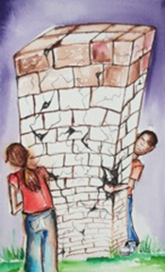
Art for Supervision and Reflection

Slide 35
Impact on the Witness
Vicarious trauma, countertransference, “burn out”, compassion fatigue, empathic strain, feeling “wounded”
Minimize the trauma, shift the focus away, denial of the existence of symptoms, and/or distancing themselves from the trauma and/or client. At times it may even involve some measure of hostility or blame on the part of the clinician toward their client.
Over-identification reactions may try to do things too quickly in their work, excessive advocacy on behalf of the client, want to rescue the client, become enmeshed, develop a blurring of role boundaries; develop an unhealthy or "pathological" bond with the client, or focus excessively on the client's traumatic experiences
Numbness, not being able to be empathetic
Harming the client and therapeutic process
http://www.netce.com/coursecontent.php?courseid=1060

Slide 36
Signs of Empathetic Breaks
Somatic reactions
Sleep disturbance
Agitation
Intense emotional reactions including sadness, depression, confusion, fear, anxiety, irritability, anger, rage, or horror
Over-identification or detachment
They may develop a sense that they have shared a unique and profound experience with the survivor—one laden with intense and private experiences of suffering that cannot be adequately described. Given the ethical and legal requirements of maintaining confidentiality, clinicians may feel very alone with a sense of a heavy burden, which can have an impact on relationships with other clients or patients and more broadly on other relationships outside of work. Over time, professionals who work with trauma survivors may become intolerant of working with non-traumatized clients, viewing their problems as insignificant in comparison to those of their trauma survivor clients. They may also become intolerant of and increasingly sensitive to violence and conflict and feel more personally vulnerable to danger
http://www.netce.com/coursecontent.php?courseid=1060

Slide 37
Interventions for Responders
Personal defense mechanisms: humor, altruism
Finding the words to precisely label and express one's inner feelings and experiences
Further training, consultation, and/or supervision
Taking needed time away and being kind and gentle with yourself
Develop insight into your feelings/behaviors/thoughts
A supportive network of others to create a "safe holding environment“ to process stories
Therapy
Develop a ritual for the end of one's work day to facilitate transition into non-work life
Relaxation and creative activities or hobbies “to provide avenues for self-expression and regenerate energy” regularly
Vicarious resilience and self-care
Rest, time to recuperate and rejuvenate themselves, proper supervision and support, and reducing their exposure to trauma and minimizing work
Finding balance
Sleep, Nutrition, Exercise
Give yourself permission to enjoy life
http://www.netce.com/coursecontent.php?courseid=1060

Slide 38
Rituals
Rituals to facilitate their ability to transition from work to home and to be able to "leave work at work." Developing rituals can be an important strategy to take care of yourself and prevent burnout.
Walking or biking home from work through a beautiful neighborhood or park
Reading an engaging and relaxing novel while taking the bus or metro home from work rather than driving in rush hour traffic
Changing out of work clothes and putting them away as soon as you get home
Taking a 5- or 10-minute period to be quiet (or to meditate) before leaving the office or when you first get home to shift gears Going for a run or exercising
Playing with your dog or child when you first get home
Putting away any work papers or charts at the end of the work day and locking your office (symbolically putting away your attention to work matters)
Watering plants in the office at the end of each work week before starting the weekend (a metaphor for life and growth, reminding you to save time for your own life and personal growth outside of work)
Questions for reflection and suggestions for experimentation:
Is there anything that you do that helps you to leave your work at work?
Do you allow yourself any transition time between work and home?
Do you have any ritual that you follow at the end of your work day? If not, for the next week, experiment by trying some ritual, reflecting on it and its affect on you. Continue to experiment until you find something that works for you.
http://www.netce.com/coursecontent.php?courseid=1060

Slide 39
Ethical Considerations
To create or not to create with the client?
Holding onto the artwork
Displaying art
Who owns the art?
Who makes the profit when selling art?
http://files.eric.ed.gov/fulltext/ED388916.pdf

Slide 40
References
Malchiodi, C. (1997). Breaking the Silence: Art Therapy with Children from Violent Homes. New York: Brunner Mazel.
Malchiodi, C. (2005). Using Art in Trauma Recovery with Children. Monograph published by the National Institute for Trauma and Loss in Children.
Malchiodi, C. (2008). Creative Interventions with Traumatized Children. New York: Guildford Press.
Malchiodi, C. (March 6, 2012). Trauma-informed expressive arts therapy. New York: Sussex Publications/ Psychology Today.
Miller, G. (2008). Bruce Perry’s Impact: Considerations for Art Therapy & Children from Violent Homes
Miller, Gretchen. Finding a Safe Place: Safety for Survivors of Domestic Violence through Art.
Miller, Gretchen. Group Art Therapy Interventions & Strategies: Working with Children Exposed to Domestic Violence
Perry, B. (2006). Applying Principals of Neurodevelopment to Clinical Work with Maltreated and Traumatized Children in Working with Traumatized Youth in Child Welfare edited by Nancy Boyd. New York: Guilford Press.
http://www.netce.com/coursecontent.php?courseid=1060

