Slide 1
Gang 101
How To Proactively Identify And Understand The Culture

Slide 2
What are Gangs?
Street gangs are groups of people that can be at risk for violence
Lack of structured
Male and females are a part of gangs
Some members are born into the gang, others have joined a gang as young as 7 years of age

Slide 3
Born into a Gang
This is when a parent is involved in gangs and their kids are raised in that lifestyle
Kids are taught to throw up / display gang signs
  Are rewarded by positive praise when done
Kids are dressed with gang colors, taught the lifestyle and code of conduct early on

Slide 4
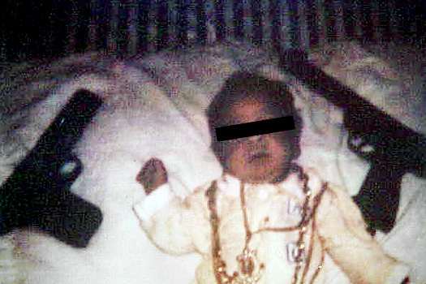

Slide 5
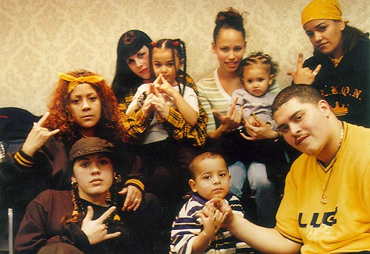
Born into a Gang

Slide 6
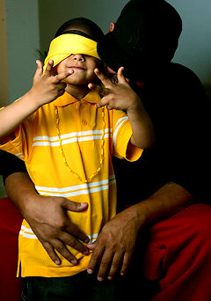
Born into a Gang

Slide 7
Gang Structure
All gangs are composed of:
  President
  Vice-President
  Treasure
  Enforcer
  Soldiers
  Gang roles / titles vary by individual gangs but functionality remains consistent
In recent years, due to the breakdown of gang structure, the lack of leadership has lead to more violence

Slide 8
How can gang representation be recognized?
Colors of clothing i.e. Black & Gold, Black & Blue etc.
Most colors combined are gang colors, look for a pattern consistent w/ everyday attire
Language:
    Moe, Peeps, Folks, Lord, Gang Gang Gang, On Gang, Opp, G, Lord, OTF among others

Slide 9
How can Gang representation be recognized?
Tattoos that are gang related
  Can be found: Face, wrist, fingers and other parts not visible
Hats tilted to the side (Rarely)
Handshakes (Always)
Hand signs (Always)

Slide 10
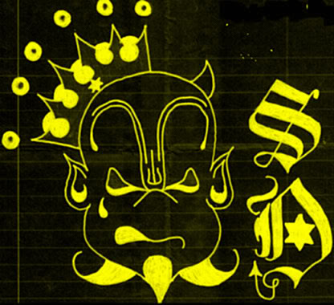


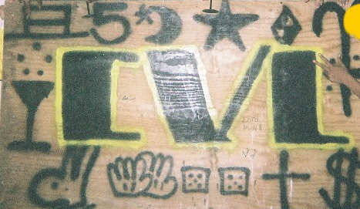

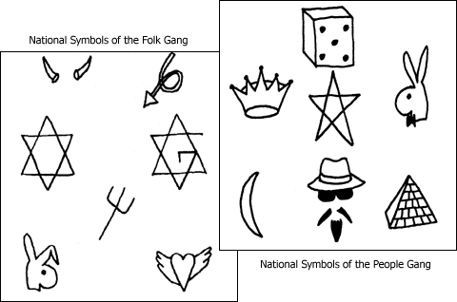
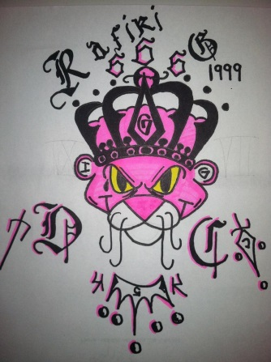



Most common gang symbols

Slide 11
Gangs and Dating
Females can be very scared to leave a gang member and often join the gang themselves
May look for safety with a rival gang member
May get abused because she dated a rival gang member
May be stalked, bullied or beaten by ex-boyfriend’s gang
If or when dating a gang member you are not to talk or hang with other gangs or else it will be consider as a betrayal, disciplinary action and even death may take place

Slide 12
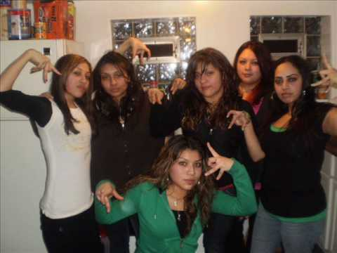
Females play a role

Slide 13
Females play a role
Young females are very loyal and easily intimidated by the male gang members. They feel a sense of belonging & pride. They will do anything to defend the clique as a “Down” “Ride or Die” female member

Slide 14
Some Major reasons why people join gangs
No strong role model
Feeling left out / trying to fit in
Peer pressure
Feeling of belonging
Broken homes
Alcohol or drug abuse i.e. marijuana, blunt, molly, drank, DXM, Lean/Purp
Girl / Boy driven i.e. crush on at risk peers
Lack of parental supervision
Media’s glorification of Gangsters‘
Family is in a gang

Slide 15
Gang Activity Mind-set and Social Media
Gangs glorified by curious youth, video games, and social media
i.e. Facebook, Instagram, twitter, Snapchat and You tube
For some it is a religion
If you are not a part of a mob / gang you are nothing (mentality)
Social Media
YouTube
  Chicago Gang TV
  Instagram @chicagogangtv
  Personal postings of gangs disrespecting each other cliques
Underground cites like
Music: Rap videos like “Shooters” by “Young Pappy & Lil Shawn that sparked the shooting death of Young Pappy as well as many others
Violent Videogames

Slide 16
What can help to avoid gang involvement?
Stay is school
Find local positive places, resources
Develop positive friendships
Identify a role model(s) or persons highly respected by youth
Set goals
Stay involved: extra curricular activities such as Sports, (positive) youth groups, after school programs and employment (Part-time or Full-Time)

Slide 17
Critical Elements of 16-25 year-old age Groups
Gang/clique/crew/mob involved 96.9%
Key role in gang 68.7%
Prior criminal involvement 62.6%
High risk street activity 92.8%
Victim of shooting in last 90 days 8.0%
Between ages 16 and 25 87.9%
Recently released from prison 25.4%
High School grad/GED 23.3%
Unemployed 70.8%
On parole or probation 37.5%

Slide 18
To Learn More Contact:
Angalia Bianca
angaliabianca2u@yahoo.com

