Slide 1
Intimate Partner Violence in Pregnancy
Wendy D. Allen APN, CNM
September 22, 2017

Slide 2
OBJECTIVES
The audience will be able to state maternal consequences of intimate partner abuse in pregnancy
The audience will be able to state the fetal consequences of intimate partner violence in pregnancy
The audience will be able to state the recommendations for screening in pregnancy
The audience will be able to state barriers to screening in pregnancy

Slide 3
Risk factors for Women
Young age (<24)
  Vulnerable
  Lack of life experience
  Nonconformist
  “Bad boy”

Slide 4
Risk factors for Women
Childhood physical or sexual victimization
  Less skilled at self-protection
  Poor self esteem
  No personal boundaries
  Acceptance of role as victim

Slide 5
Risk factors for Women
Witnessing violence as a child
  Increased risk of social/interpersonal problems
  Poor parenting skills
  Lack of role models
  This is the “norm”

Slide 6
Risk factors for Women
Less educated
Unemployment/Poverty
American Indian/Alaska Native or African American

Slide 7
Additional Risk factors
Couples with income/educational or job disparities
Excessive jealousy or possessive behavior
Dominance/control of the relationship by the male partner
Unresolved PTSD
Substance abuse by the male partner

Slide 8
Additional Risk factors
Unplanned/unwanted pregnancy
  50% of pregnancies in the United States are unplanned

Slide 9

Samantha’s Story

Slide 10
Reproductive Coercion
Contraceptive sabotage
Pregnancy pressure
Abortion pressure

Slide 11
Health Effects
Severity of abuse impacts physical and mental health
Effects of abuse are cumulative over time
Effects last long after abuse has stopped
Delayed prenatal care

Slide 12
Physical Effects
Dependent on severity and frequency of abuse
“Thick chart syndrome”
Increased morbidity/mortality of pregnancy

Slide 13
Psychological Consequences
Poor self esteem
Phobias
Abnormal affect
Substance abuse

Slide 14
Psychological Consequences
Antenatal Depression
    Treatment with SSRI’s
    Neonatal consequences of exposure to SSRI’s
Post-Partum depression
  Impaired infant bonding
  More difficult infant temperament
  Increased anxiety in offspring

Slide 15
Psychological Consequences
Insomnia
Eating disorders
Sexual dysfunction

Slide 16
Fetal Consequences
Miscarriage/First and second trimester bleeding
Injury to the fetus

Slide 17
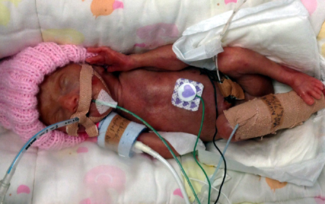
Fetal Consequences
Preterm labor and delivery

Slide 18
Consequences of Prematurity
Hypothermia
Respiratory Distress
Chronic lung disease
Apnea
PDA

Slide 19
Consequences of Prematurity
IVH
Glucose abnormalities
NEC
Infection
Retinopathy

Slide 20
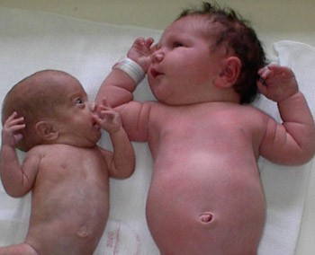
Fetal Consequences
Intrauterine growth restriction

Slide 21
Fetal Consequences
Fetal demise

Slide 22
Screening Recommendations
During pregnancy
  Initial visit
  Each trimester
  Post-partum visit

Slide 23
Red Flags
Avoidance of procedures
Fear out of proportion to circumstances
Intolerance of minor discomforts
Frequent Urgent visits/ER visits
Missed appointments
Disassociation

Slide 24
Red flags
Overly attentive partner
Reluctance to undress
Medication non-adherence

Slide 25
Labor Management
Development of birth/safety plan that reflects woman’s wishes
Promote an atmosphere of change for the family
How to work with abusive partners/toxic family members
Be aware of “trauma echoes”

Slide 26
Why Not Leave?
No guarantee things will be better/safer
Custody issues
Poverty
Culture/faith

Slide 27
Other Screening Opportunities
Well woman exam
Recurrent Problem visits

Slide 28
Barriers to Screening
Provider/Patient discomfort

Slide 29

Barriers to Screening
      Mary’s story

Slide 30
Barriers to Screening
Lack of knowledge
Time constraints

Slide 31
Barriers to Screening
Privacy/Legal concerns
Personal safety concerns

Slide 32
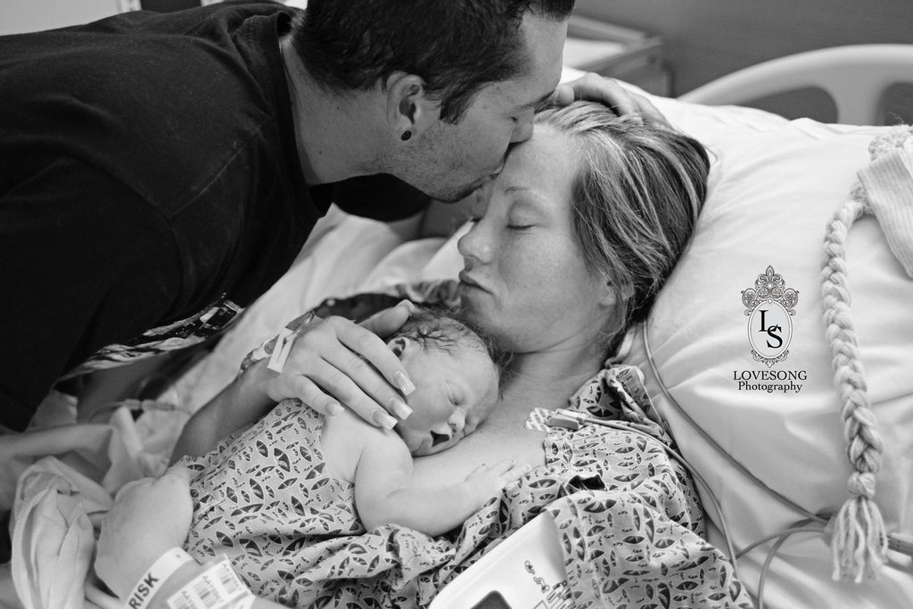
Barriers to Screening
Katie’s story

