Slide 1

Head Cornerstone
Basics of Trauma-Informed Care
Kelsey Salazar, LPC, CSOTP
Psychotherapist
Scott Cox, LCSW
Clinical Director

Slide 2
Defining trauma is easy… right?
Origin of trauma
DSM-5: “…exposure to actual or threatened death, serious injury or sexual violence in one of the following ways:
  Directly experiencing the traumatic event(s)
  Witnessing, in person, the event(s) as it/they occurred
  Learning the traumatic event(s) happened to a family member or close friend
  Experiencing repeated or extreme exposure to aversive details of traumatic event(s)
    First responders
    Police officers
    Child welfare professionals
    Psychotherapists

Slide 3
Is this our standard?
Thinking outside of the DSM-5 “box”
LIMITATIONS
ALTERNATIVE DEFINITION
DSM definition significantly underestimates the extent of trauma in the general population.
It also fails to incorporate extreme emotional abuse, major losses/separations, degradation or humiliation, and coerced sexual experiences.
An extremely upsetting experience that overwhelms an individual’s internal resources and produces
lasting psychological symptoms.

Slide 4

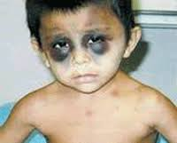

Complex Trauma
But what about ME?
Exposure to severe stressors that:
Are repetitive
Involve harm or abandonment
Occur at developmentally vulnerable periods

Slide 5
Different Types of Trauma
Type I: Single Event
Type II: Recurrent/Ongoing
Unexpected/“out of the blue”
Single episode; not recurrent
Polyvictimization (Finkelhor, Ormrod, & Turner, 2007)
Often involves fundamental betrayal of trust
Often occurs at critical developmental periods

Slide 6

Traumatic Events
Some examples
Mass interpersonal violence
Large-scale transportation accidents
Natural disasters
Fires
Combat/war/terrorism
Physical assault
Rape/sexual assault
Child abuse
Intimate partner violence
Torture
Sex trafficking
Life-threatening medical conditions
Emergency worker exposure to trauma

Slide 7
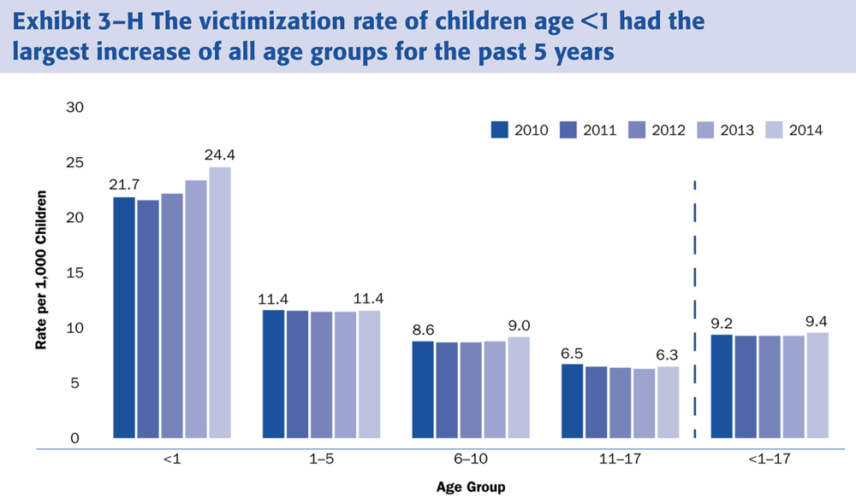
Child Abuse Statistics

Slide 8
Child Abuse Statistics (cont.)
National
Illinois
Last year, there were 702,000 child victims of abuse and neglect. That’s 9.2 victims per 1000 children in the U.S.
More than 4 children die every day as a result of child abuse.
Over 70% of children who die from child abuse are under the age of 3.
More than 90% of juvenile sexual abuse victims know their perpetrator.
14% of all men and 36% of all women in prison in the U.S. were abused as children. This is about 2x the rate seen in the general population.
Children who experience child abuse and neglect are about 9x more likely to become involved in criminal activity.
In 2013, Illinois had 66,528 total referrals for child abuse and neglect.
In 2013, 29,719 children were victims of abuse or neglect, a rate of 9.8 per 1000 children, representing a 7.5% increase from 2012.
  Of these children, 77.8% were neglected, 26.2% were physically abused, and 17.9% were sexually abused.
The number of child victims has increased 8.3% in comparison to the number of victims in 2009.

Slide 9

Intimate Partner Violence Statistics
In 2014, almost 65,800 intimate partner violence incidents were reported to Illinois law enforcement. Many others went unreported.
Between July 2013 and June 2014, there were 84 domestic violence-related deaths in Illinois, including 15 children.
26.9% of domestic violence homicides in Illinois were committed with
firearms, significantly less than the nationwide rate.
72% of all murder-suicides involve an intimate partner. 94% of the
victims of these crimes are female.
1 in 3 women and 1 in 4 men in the U.S. have experienced some form
of physical violence by an intimate partner.

Slide 10
Sexual Assault Statistics
1 in 5 women and 1 in 71 men will be raped at some point in their lives.
46.4% of lesbian women, 74.9% of bisexual women, and 43.3% of heterosexual women reported sexual violence other than rape during their lifetimes, while 40.2% of gay men, 47.4% of bisexual men, and 20.8% of heterosexual men reported sexual violence other than rape during their lifetimes.
Nearly 1 in 10 women has been raped by an intimate partner in her lifetime, including completed forced penetration, attempted forced penetration, or alcohol/drug-facilitated completed penetration.
Approximately 1 in 45 men has been made to penetrate an intimate
partner during his lifetime.
91% of victims of rape an sexual assault are female, and 9% are male.
In 8 out of 10 cases of rape, the victim knew the person who
sexually assaulted them.

Slide 11
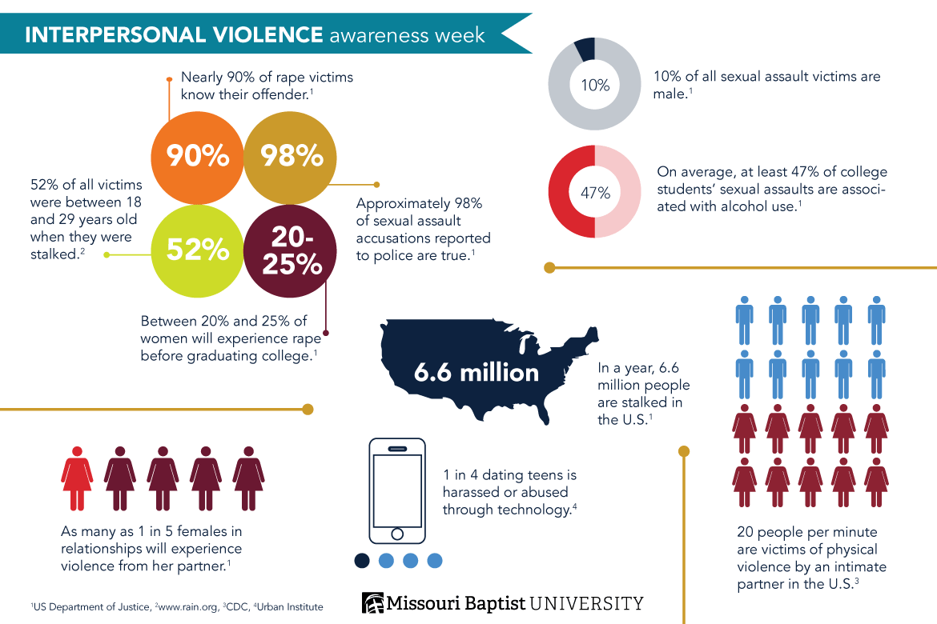

Slide 12
Trauma-Focused Diagnosis
Brief Psychotic Disorder?
Body Dysmorphic Disorder?
Hoarding Disorder (i.e. food)?
Dissociative Disorder?
  Dissociative Amnesia
  Depersonalization/Derealization Disorder
Reactive Attachment Disorder
Disinhibited Social Engagement Disorder
Posttraumatic Stress Disorder
Acute Stress Disorder
Adjustment Disorder

Slide 13

Trauma Symptoms
Negative alterations in cognition and emotions
Re-experiencing
Avoidance
Numbing
Re-enacting
Arousal
Depersonalization
Derealization

Slide 14
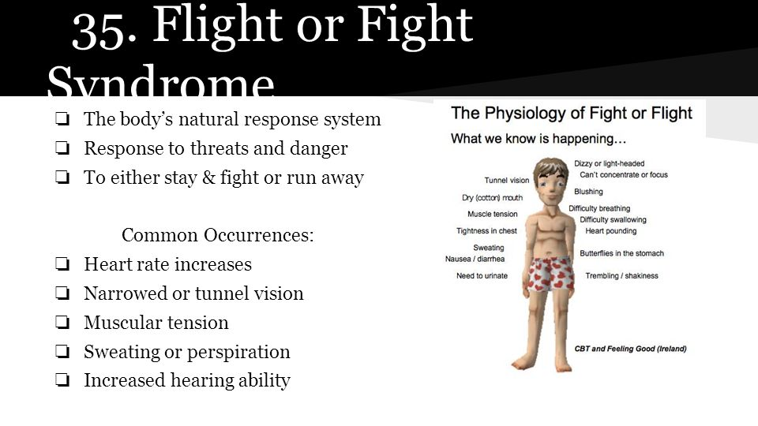
https://www.youtube.com/watch?v=P_ESNG0zfZM&feature=youtu.be
https://www.ted.com/talks/nadine_burke_harris_how_childhood_trauma_affects_health_across_a_lifetime?language=en#t-561401

Slide 15
Individual
Survival Mode
Protective Factors
Danger Response Syndrome
Resilience
Post Traumatic Growth
Storage and Retrieval Strength

Slide 16
Protective Factors
Supportive family environment
Nurturing parenting skills
Stable family relationships
Household rules and monitoring of the child
Parental employment
Adequate housing
Access to health care and social services
Caring adults outside family who can serve as role models or mentors
Communities that support parents and take responsibility for preventing abuse

Slide 18



Betrayal Trauma

Slide 19
Short Break
Please be back ready to go in ten minutes

Slide 20
Experiential education
Shall we process

Slide 21
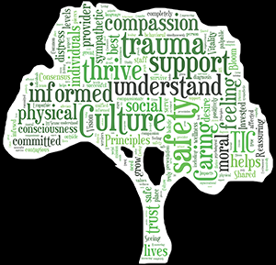
Trauma-Informed Care
Trauma Informed Care is an organizational structure and treatment framework that involves understanding, recognizing, and responding to the effects of all types of trauma.

Slide 22
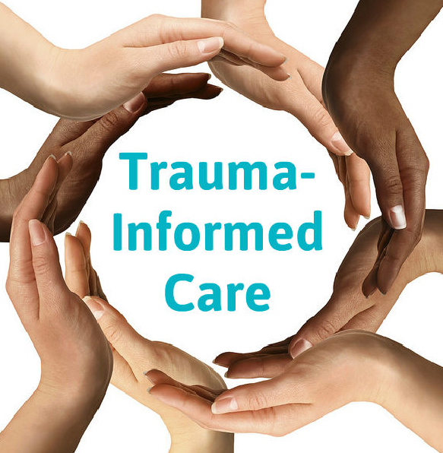
Components of Trauma-Informed Care
Administrative commitment to change
Hiring practices
Staff training and education
Review of policies and procedures
Universal screening
Physical and emotional safety
Collaboration
Trustworthiness
Choice and control
Empowerment and skill building
Language

Slide 23
Key Domains of Trauma-Informed Care
Early screening and comprehensive assessment – If the client isn’t talking, ask: “What’s happened?” (Don’t ask: “What’s wrong with you?”) Not everyone is ready to talk but we give them permission to talk when they are ready.
Consumer driven care and services – Listen to the people who are coming to us for services. Ask them if you can improve your services. Ask what can we do to help you better?
Trauma-informed, responsive and educated workforce – Everyone in the system from the receptionist through the doctor matters. Disrespect can be triggering.
Emerging and evidence-informed best practices – We need to use universal precautions. We need to expect either childhood experience or a current trauma but once we ask what happened, we need to provide EBP assistance.
Safe and secure environments – It is important for the clinician to make it safe for the client. The organization also needs to make the client feel safe and comfortable (or is the waiting room dingy and dark?).
Create trauma-informed community partnerships – This is very important to include in our work. Reach out to other organizations such as schools, the juvenile justice system etc. We need to spread this information to our partners in the community.
Develop a performance monitoring system – Develop a data collection system to demonstrate what are the outcomes that you are seeing.

Slide 24
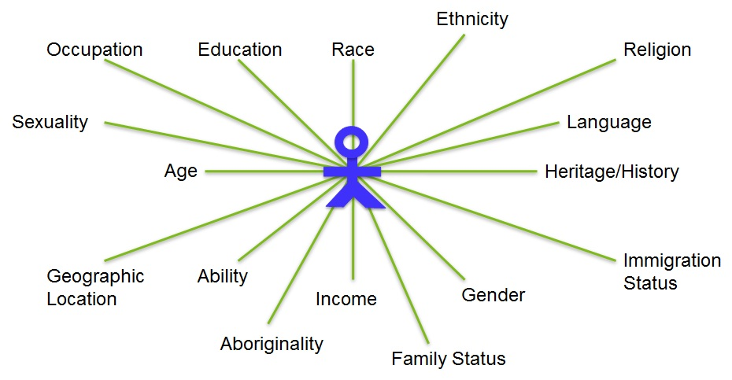
Trauma Informed vs. Trauma Focused

Slide 25
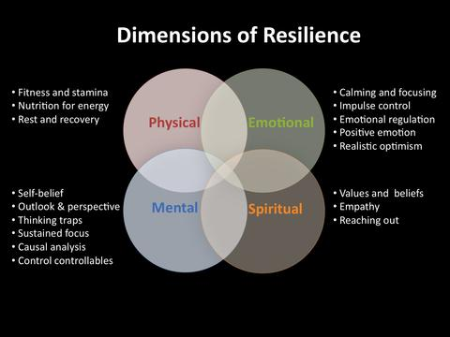
What roles does intersectionality and culture plan in trauma informed care?

Slide 26
Questions?

