Slide 1
Using Social Media to Identify and Detect Potential Violence in the Target Area

Slide 2

Lets talk about what we already know!

Slide 3
Current Identification and Detection Strategies
In Relation to Shooting & Homicide:
Online (Beefs) disputes to off line violence
Identify Potential Retaliatory Behavior
Emoji's from Grieving (Sadness) to Anger
24-48 Critical Window to Intervene And Prevent
In-person contacts with at-risk youth

Slide 4

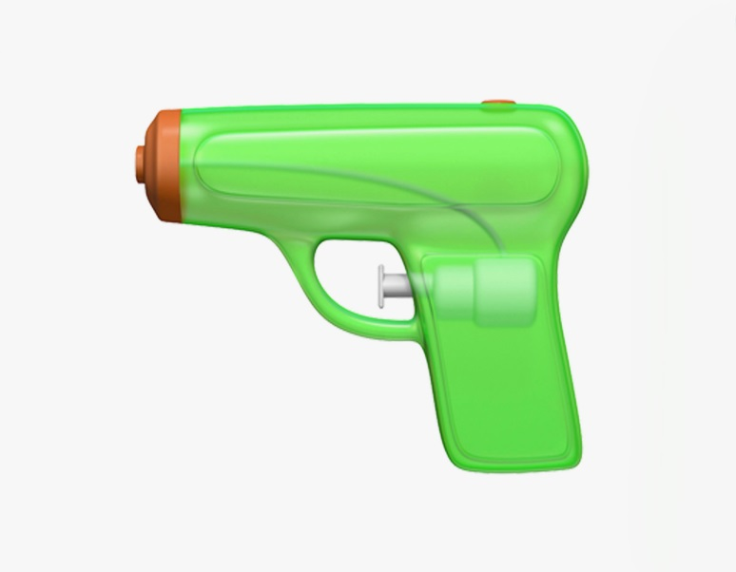
Loss & Sadness To Anger & Retaliation

Slide 5
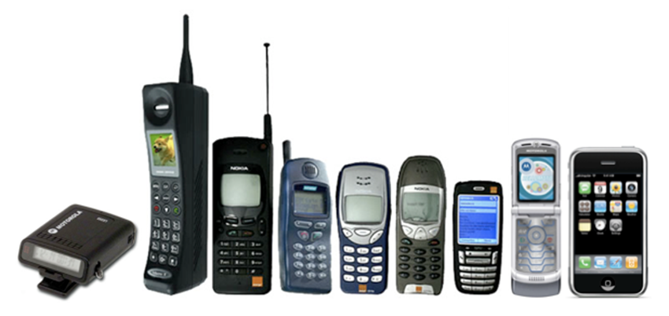
“Keeping up with the streets is like keeping up with technology…
… you can become outdated overnight.”

Slide 6
What has changed with Social Media?
Norms in….
Social Media Platforms
Internet Bashing
Gangs Taunting Rivals
Intentional Disrespectful Posts
Street Cred Based On # Of FB LIKES

Slide 7
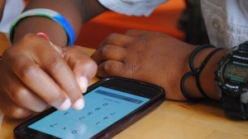
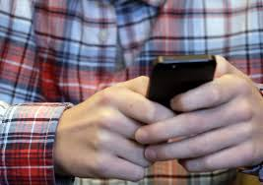
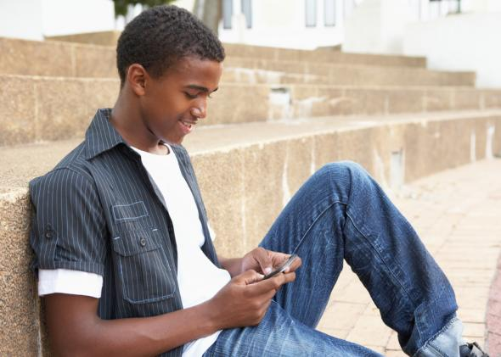
Technology and its Effects on Violence

Slide 8
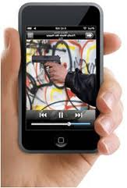
New Phenomenon:“Internet-Banging”
“Social media outlets meant to build and maintain social networks are being used to provoke, perpetrate and publicize violent acts…. changes in online behavior and usage created new and expedient ways of developing social networks, have allowed individuals to craft alter-egos and posture in ways that resemble hyper masculine behaviors displayed in urban community.”
-Butler & Eschmann.
Computers in Human Behavior (2013)
http://www.sciencedirect.com/science/article/pii/S0747563212003779

Slide 9
Communication Tools and Violence
Social Media used for:
Public bullying, victimizing, and humiliation.
self-promotion.
Historical:
“We see social media being used as a tool for self-promotion, and a way for individuals to gain and maintain street credibility….
…there seems to be a relationship between internet banging and hip hop/Rap. Social media outlets are the primary means through which individuals can display the extent to which they “keep it real,” a position once occupied by hip hop. We find that violent acts against hip hop musicians in the 1990s gave rappers incentive to separate the aggressive content in their music from their actual lifestyles.”-Butler & Eschmann. Computers in Human Behavior (2013)
1990’s: Biggie/Tupac (lyrics/music videos)
2000’s: Chief Keef/Jojo etc..(YouTube,Facebook)

Slide 10
Following Violent Behaviors
The next slides show images and videos from real situations of social media and violent influences.
Please consider these situations and relate to the current high risk social media activity that goes on in your area.

Slide 11
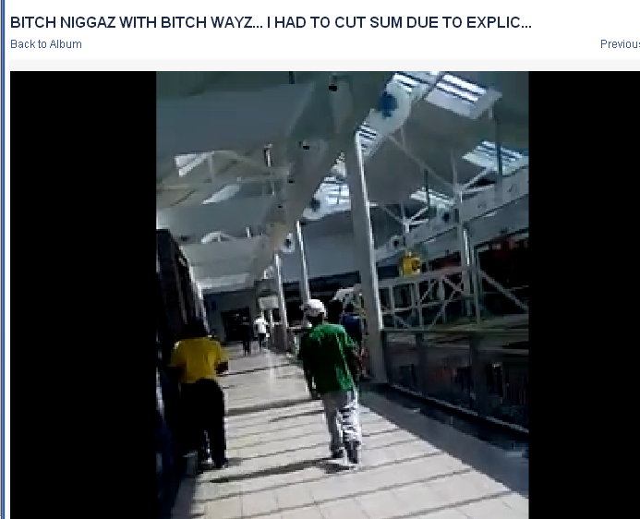
https://www.facebook.com/video.php?v=701939433194371&set=vb.100001349613061&type=2&theater
Notes:
The following is a video filmed by Group ‘A’ at the local mall where they ran into rival Group ‘B’. Group ‘B’ just lost a fellow member due to gun violence one week prior. Group ‘B’ attributes the recent murder to Group ‘A’, however no one was ever arrested in that case.

Slide 12
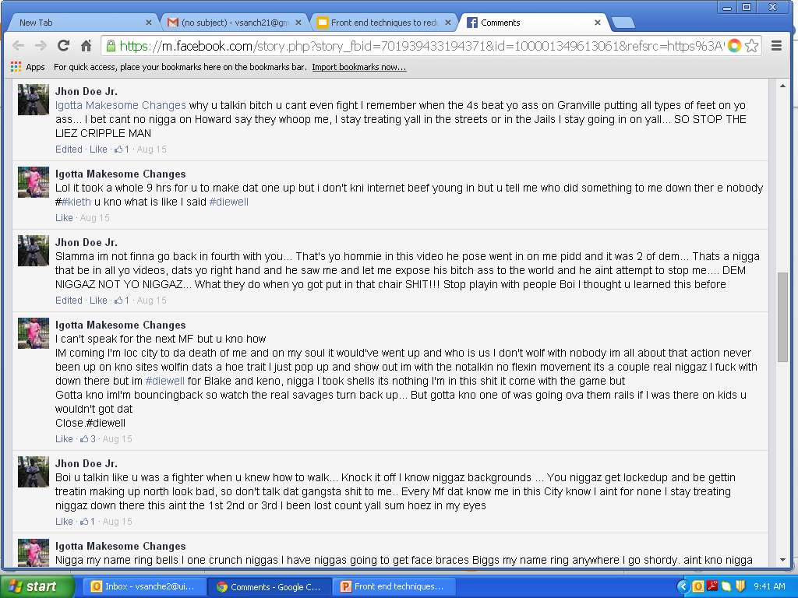
Notes:
Cliques arguing on social media sparks violence. This news feed is between a victim who was shot, (leaving him paralyzed in a wheel chair) and the alleged shooter. CV staff can monitor social media as a tool to detect violence & stop it on the front end before it leads to injury and/or death.

Slide 13
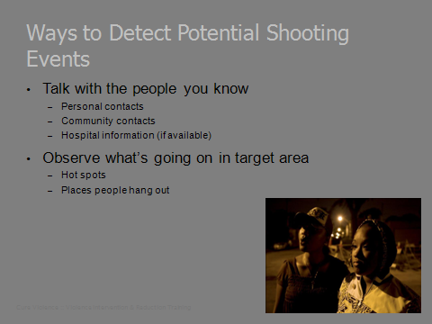
In-Roads Development Plan
Take from what we know…
Continue to:
Talk with the people you know
Observe what’s going on in target area
Physically walk the area and take a pulse of the community
But now we must also include:
Checking social media
Being aware of new statuses/pictures/videos about the target area

Slide 14
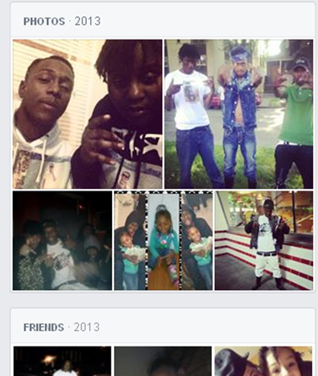
Notes:
Since these photos were taken in 2013 all of these young men have been killed from gun violence stemming directly from social media taunts & disrespectful posts & comments aimed at their rival groups.

Slide 15
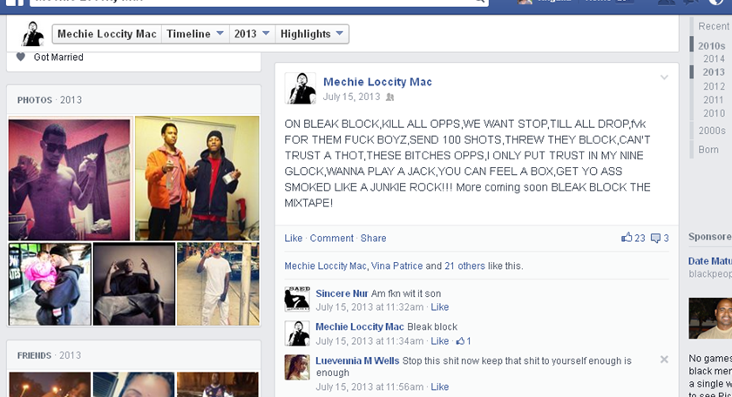
Notes:
It has become the “NORM” on the streets to name the block, clique and the world after someone shot & killed.

Slide 16
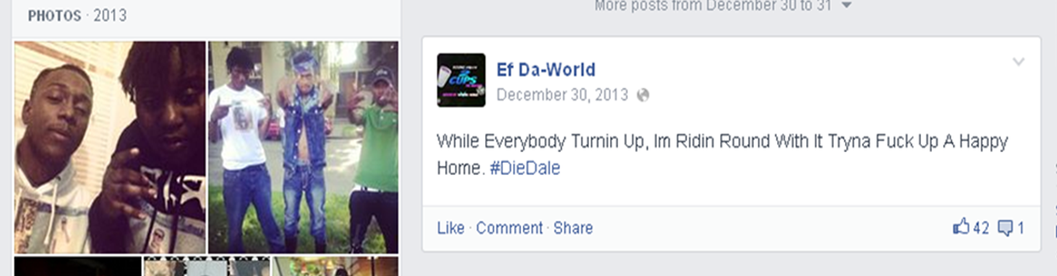
Identification of Potential Conflicts
Indirect tips may easily be seen on social media
Key players
Source of conflict
Notes:
*Remember YOU are a ROLE MODEL. Never LIKE a post on social media if it is negative displaying weapons, drugs or violence. Instead intervene with a positive comment whenever possible to defuse the situation (if in fact) you have a relationship with those individuals.

Slide 17
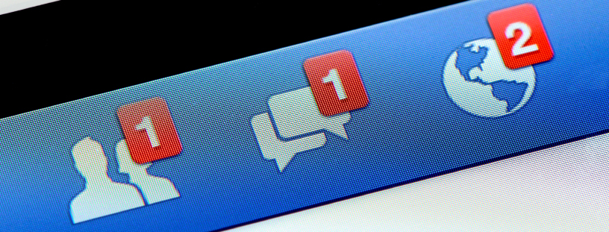
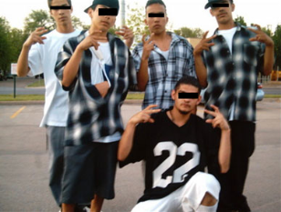
Using Social Media for Detection
From those relationships, discover who else they are connected to:
comment/hang with/or “Like” certain pictures
Search for noticeable trends or traits of high risk social media behavior: bashing, videos, shout outs
Notes:
Friending and following high risk on social media gives us the opportunity to meet them where they are and build stronger relationships

Slide 18
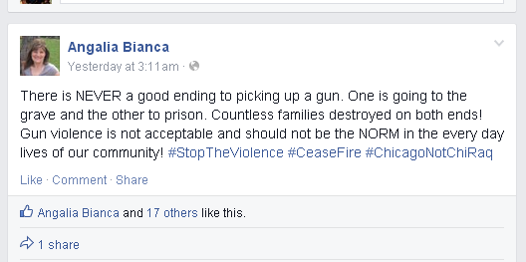
Professionalism on Social Media
Be the message you choose to bring.
Stay consistent.

Slide 19
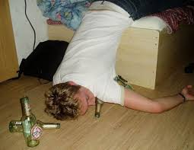
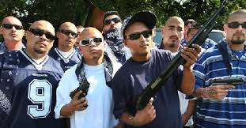
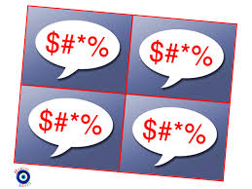
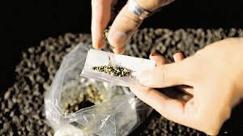
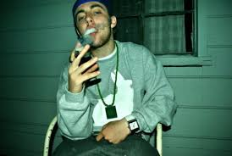
The Whole WWW is Watching

Slide 20
For any questions or additional help
Angalia Bianca
angaliabianca2u@yahoo.com

