Slide 1
Compassion Fatigue:
Realities and Resources
robert b sanoshy, lcsw
-the cairn practice-
robertbsanoshy@gmail.com
773.991.5321

Slide 2
welcome
background
my week

Slide 3
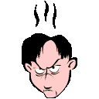
THAT is compassion fatigue

Slide 4
props props props

Slide 5
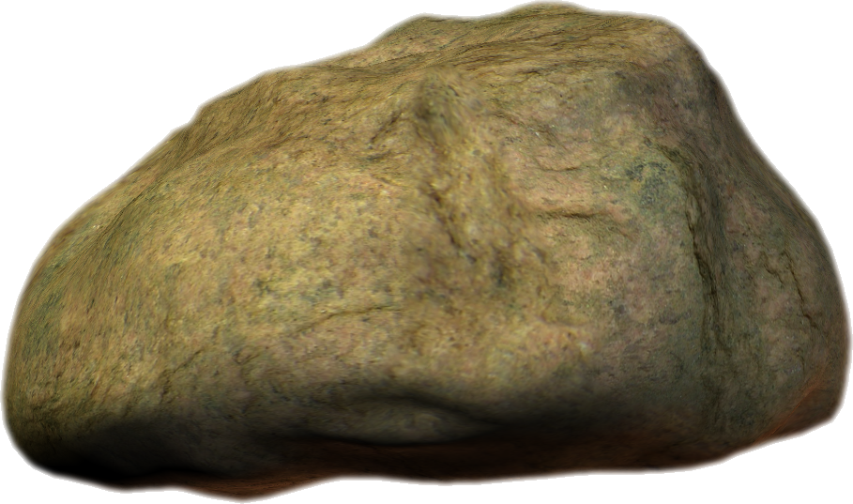
non-judgment

Slide 6
non-judgment
basis for everything we do
shame has never propelled someone to joy
none of us are above descending into harmful behavior
cannot look at any other stage of the process if we are being judgmental

Slide 7
acknowledgement

Slide 8
acknowledgement
I am human
I need help
I have screwed up
I am special…
  which makes me not that special at all, because we are all precious, unique snowflakes
STAND UP!!!

Slide 9

practice, practice, practice
be the bee…

Slide 10
realities

Slide 11
realities
work is hard and intense
we only have so much capacity
  we’re not that special…only so many hours in the day
we all have personal histories
we hold other peoples joys and sorrows- their triumphs and travesties
humans have a deep sense of wanting to survive
  even maladaptively

Slide 12
realities
if we think we are above needing help ourselves, we are inherently judging our clients
there is no helping others until we put our own mask on first
we all have lives outside of our work
whether we work with both experiencers and offenders…we hold both energies
unless you do this work, you cannot truly understand what this work does to you

Slide 13

practice, practice, practice
smile….

Slide 14
vulnerabilities

Slide 15
vulnerabilities: energy expenditures
Environment
  Noise
  Pollution
  Traffic
  Weather
  Politics
Physiological
  Illness
  Injury
  Hormones
  Inadequate sleep/nutrition
Thoughts
  Negative self-talk
  Catastrophizing
  Perfectionism
  Personalizing
  Shoulds/Musts
Social Stressors
  Financial problems
  Work
  Family
  Social events
  Loss

Slide 16
vulnerabilities symptoms
Physical
  Muscle tension
  Headaches
  Illness
  Ulcers
  Indigestion
  Difficulty sleeping
Emotional
  Depression
  Anger
  Fear
  Anxiety
  Mood Swings
  Feelings of Inadequacy/Being Overwhelmed
Cognitive
  Forgetfulness
  Repetitive Thoughts
  Difficulty Concentrating
  Inability to focus

Slide 17
vulnerabilities maladaptive behaviors
Increase in smoking/drinking
Acting out sexually
Suicidal ideation
Overspending
Rage
Drug use
Physical violence to self/others
Isolation
Disruptive eating (over/under)

Slide 18
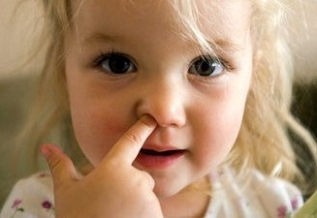
practice, practice, practice
breathe…

Slide 19
resiliencies

Slide 20
resiliencies
Emotional
Intellectual
Physical
Sexual
Spiritual
Familial

Slide 21

resiliencies
Balancing Energy Expenditures
  vs
Energy Replenishers

Slide 22
resources

Slide 23
resources
Attitude
  Positive self-talk
Healthy eating
Physical activity
  Energy increase, Increase in concentration, Improves physical appearance/self esteem, Sleep improves, Fewer illnesses, Strengthens heart- assists with flight/fight response to stress
Relaxing your mind and body
  Meditation, deep breathing, visualization
Sleep
  Regular schedule, avoid caffeine & alcohol before bed
Healthy relationships
  Reciprocal, ability to be self/grow
Time management
  Anticipate, plan, break tasks down, cross things off
Alcohol and other drugs
Tobacco
  Impacts sleep, ability to fight infection and overall health
Money management
  Budget, budget, budget!!!
Yoga
  Research
Mindfulness
Supervision
Training
Spirituality
  Sense of purpose, knowledge of self, connection to something other than self, sometimes religious/sometimes not

Slide 24
practice, practice, practice
wash, rinse, repeat…
Who am I? I am me
Where am I? I am here
What time is it? It is now
What am I doing? I am doing the best I can

Slide 25
gratitude

Slide 26


gratitude
we have to be grateful for the rain in order to appreciate the rainbow

Slide 27
forgiveness

Slide 28
forgiveness
forgive everyone…
for everything…
all of the time…
starting with yourself…

Slide 29

practice, practice, practice
thanks & forgiveness…

Slide 30
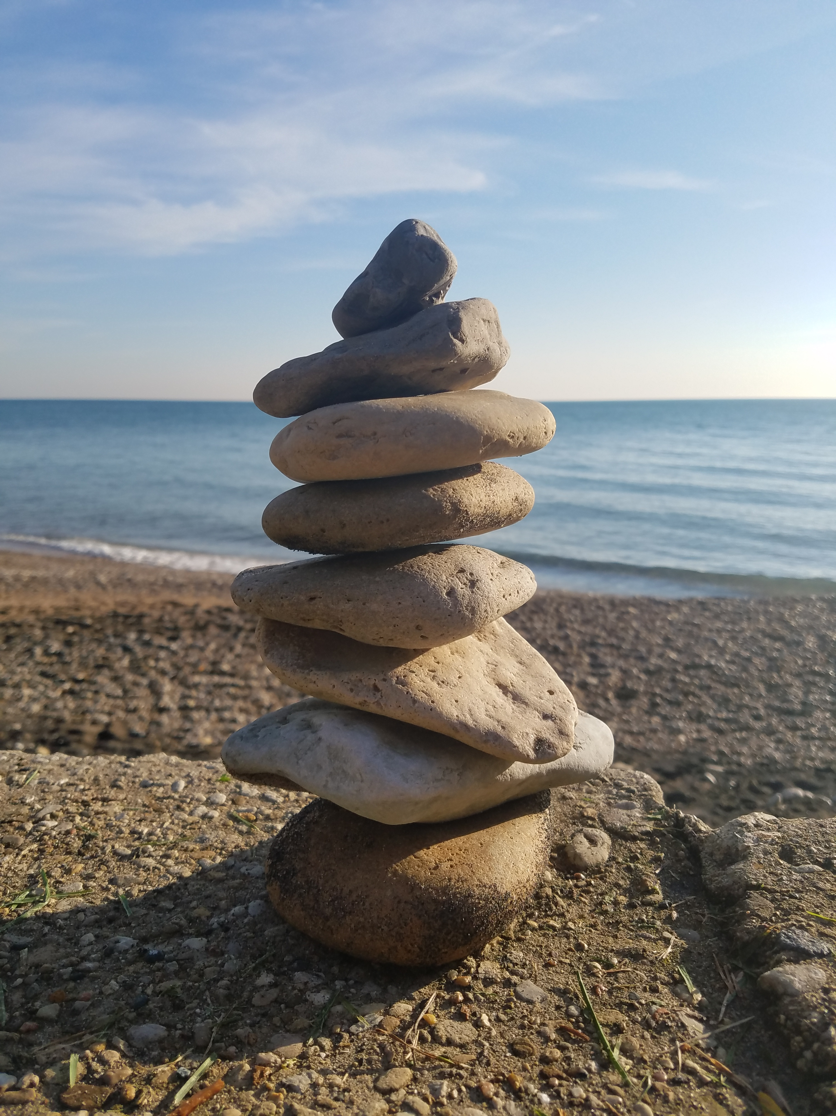
the cairn

Slide 31

practice, practice, practice
so what…

Slide 32
namaste

